Slide 1

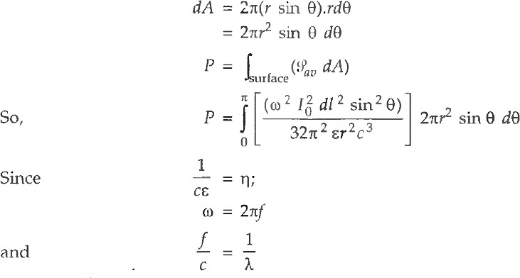
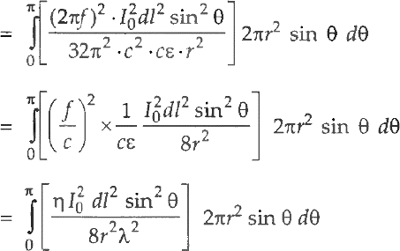
Antenna and Wave Propagation Electromagnetic Spectrum
Power radiated by a current element
The average poynting vector is given by:-
This is the power radiated by the current element along the radius vector r of the sphere and is perpendicular to (𝜑) and (𝜃). The total power radiated is obtained by taking the surface integral of over any surface enclosing the current element as shown in Figure below. The point P is independent of azimuthal angle 𝜑, thus the elemental area on the spherical shell is

Slide 2

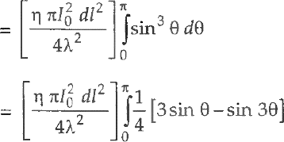
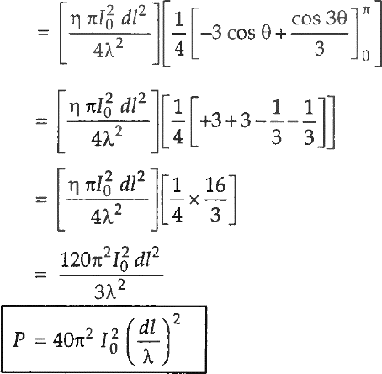
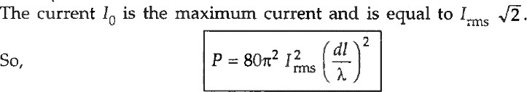
Antenna and Wave Propagation Electromagnetic Spectrum
This power is the radiated power, i.e., the real part of the power dissipated by the current dement. The imaginary or the reactive part of power is in the induction field.

